Slide 1
Early Warning for High School Dropout: A Machine Learning Approach
Predicting dropout risk using HSLS:09 longitudinal data to enable early intervention and support at-risk students.
Nafe Abubaker Afaf Amwas Ayham Al-Duwairy Heba Qasem Tala Hliqawi
April 4, 2026
Group 1

Slide 2
Table of contents
01
Problem Statement
04
EDA insights
02
Dataset
05
Feature Selection
03
Columns Selection & Data Cleaning
06
Modeling and Results
07
Business Recommendation & Next Steps

Slide 3
01
Problem Statement

Slide 4
Problem & Goal
Why does this matter — and who needs this tool?
The Problem
High school dropout carries lasting consequences for students — reduced earnings, limited access to further education, and systemic social costs. Yet most interventions happen too late, after students have already disengaged.
Our Goal
Build a machine learning model using 9th-grade data to flag students at risk of dropping out — early enough for schools to intervene effectively.
Primary Stakeholders
→ School counselors & administrators
→ Education policymakers
→ Intervention program coordinators

Slide 5
2.1 Million
Annual Dropouts in the United States in 2022 according to the NCES
Source: National Center for Education Statistics (NCES) - Status Dropout Rates

Slide 6
Consequences of Dropping Out
Economic Cost ($272,000 to $298,000)
Poverty Risk (25.1% vs. 13.1%)
Unemployment (13% vs. 7%)
Sources: Research.com – High School Dropout Rate, Statista – Poverty Rate by Education Level U.S. 2023,
NCES – Trends in High School Dropout and Completion Rates

Slide 7
02
Dataset

Slide 8
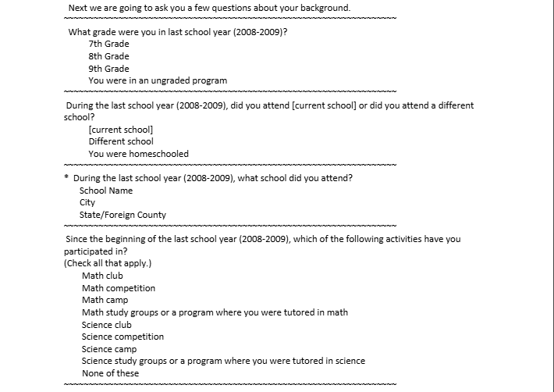
High School Logitudinal Study
25000+
Total Rows
9000+
Total Columns
50
States Plus DC
2009-2016
Study Period
Data Collection Timeline
2009
2012
2013
2016
Base Year
1st Follow-up
Update
2nd Follow-up
9th grade
11th grade
Target measured
Target Variable
X4EVERDROP
Binary: Did this student ever have
a known dropout episode by 2016?
This project focuses exclusively on the student-level file (student questionnaires + assessments).

Slide 9
03
Column Selection & Data Cleaning

Slide 10
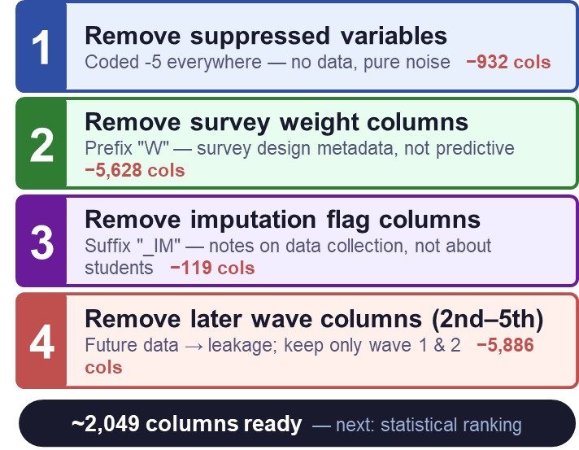
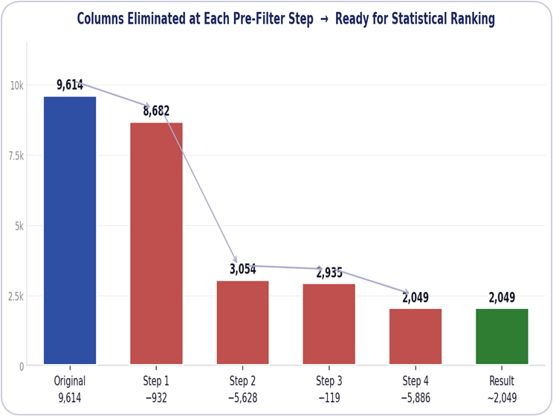
Column Selection — Pre-Filtering
Before any statistical ranking, we applied 4 rule-based filters to shrink 9,614 columns down to ~2,049

Slide 11
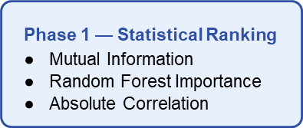
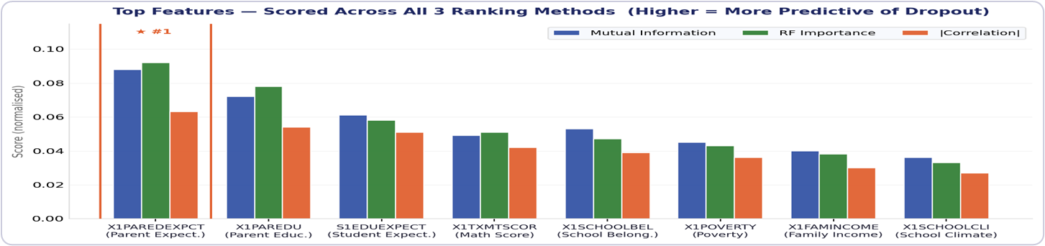
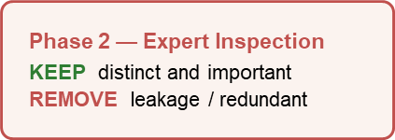
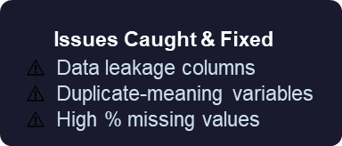
Column Selection — Ranking & Inspection
From ~2,049 columns down to 44 — statistical scoring followed by expert judgment

Slide 12
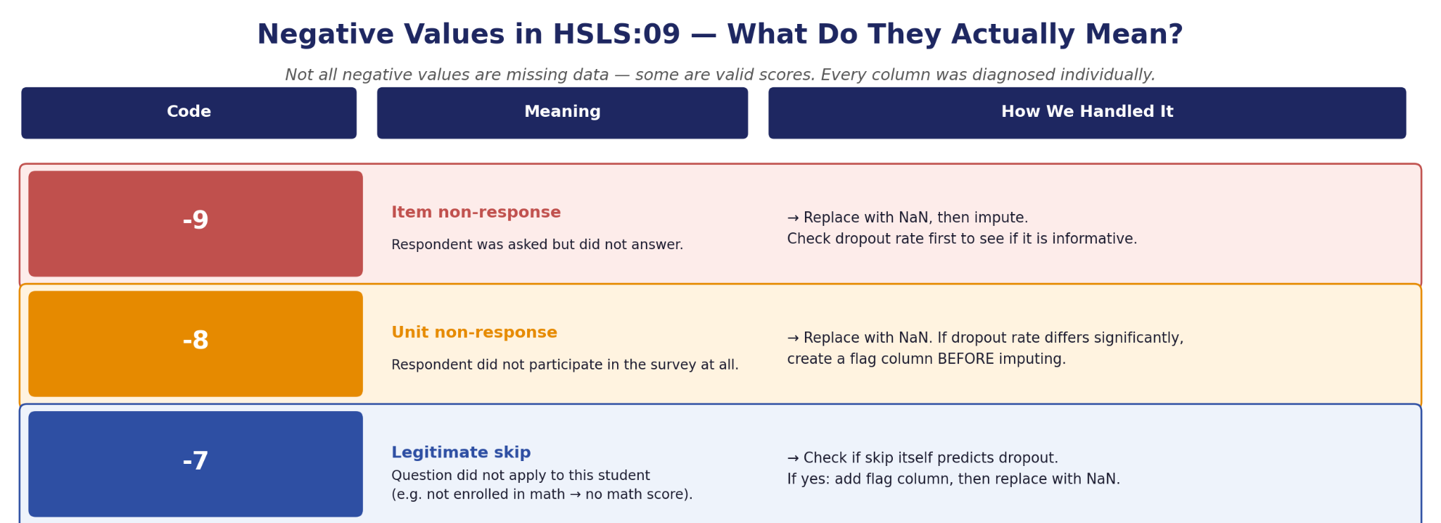
Data Cleaning

Slide 13
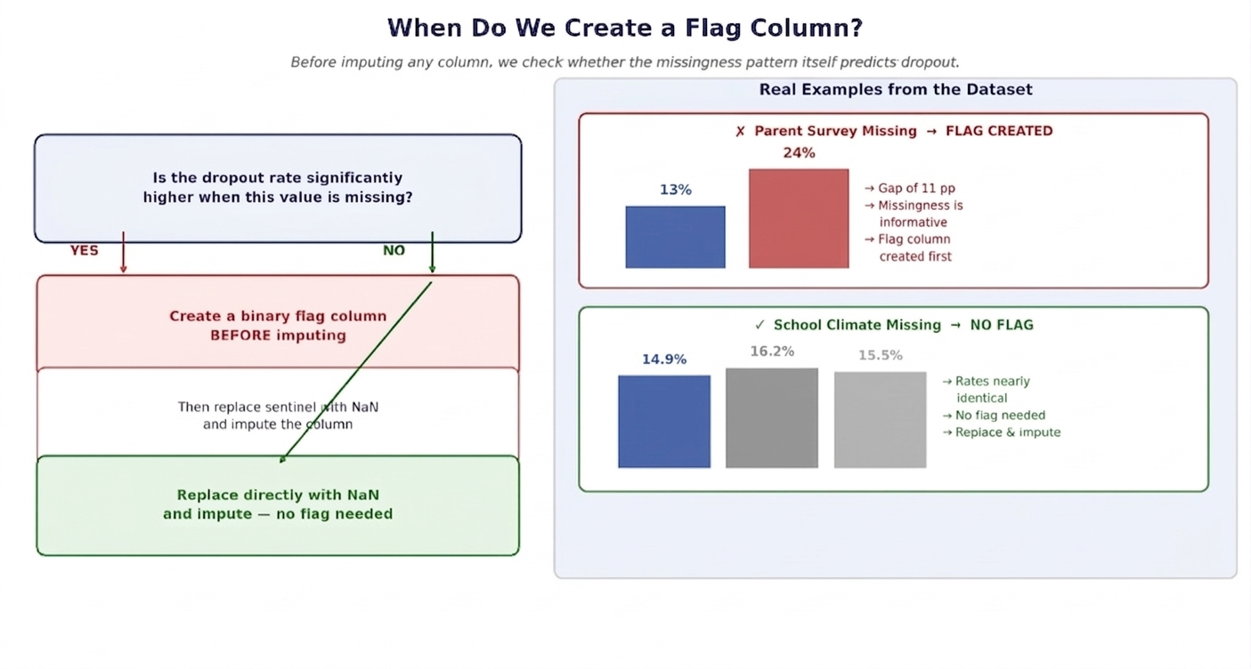
Data Cleaning
Parent responded
Parent did not respond
-7
-9
-8

Slide 14
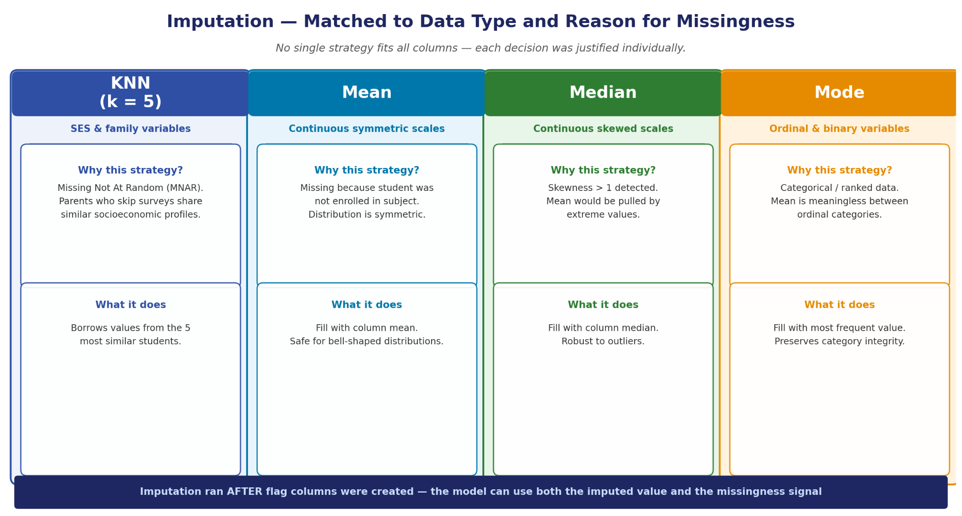
Data Cleaning

Slide 15
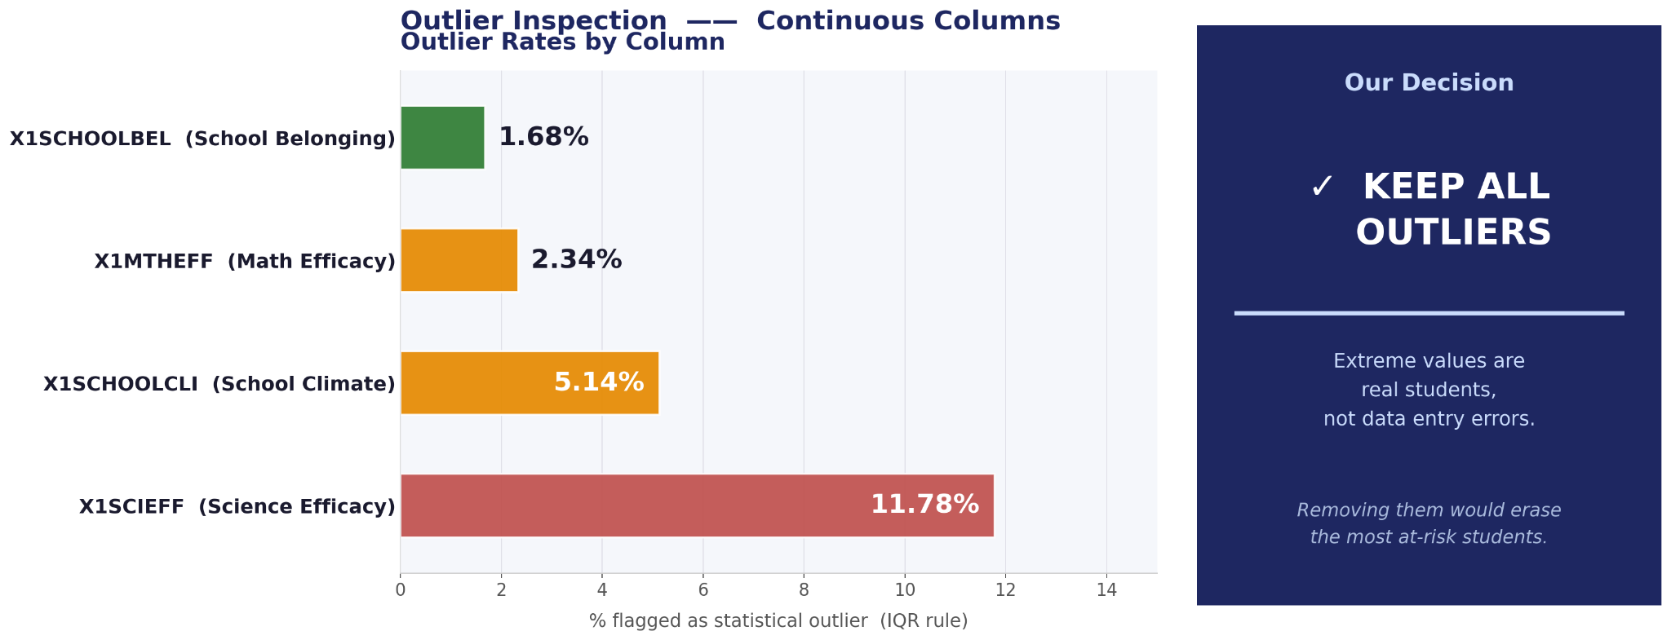
Data Cleaning

Slide 16
04
Presenting EDA Results

Slide 17
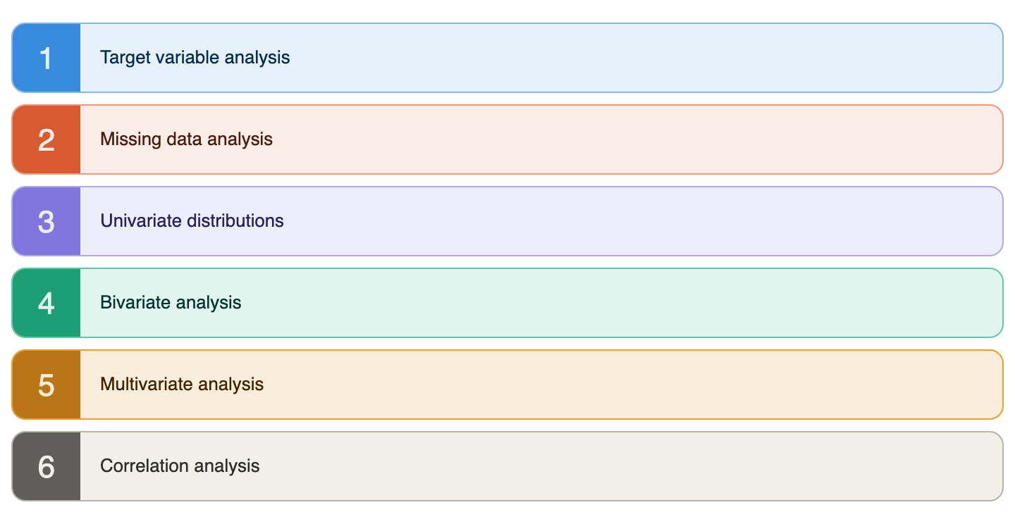
EDA Steps

Slide 18
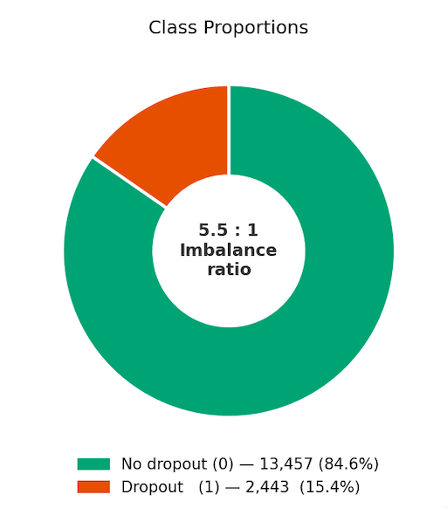
Target Variable Disitribution
Notes:
15,900 students total
2,443 (15.4%) dropout
13,457 (84.6%) no dropout
5.5:1 imbalance ratio — a naive "always predict no dropout" model would be 84.6% accurate but useless

Slide 19
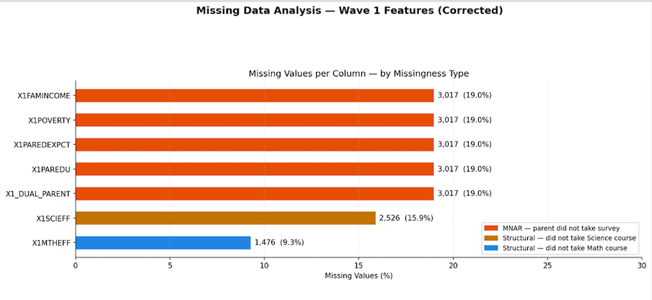
Missing Data
Notes:
Difference between MNAR+ Structured The feature engineered column “Parent missigness or disengagement”

Slide 20
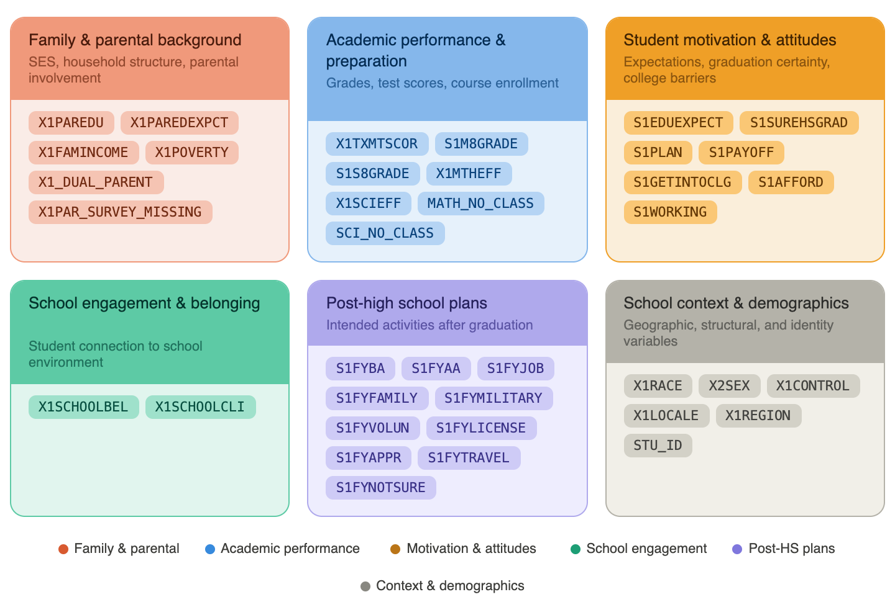
Different Domains
Notes:
The three top cards (Family, Academic, Motivation) are the primary story domains with confirmed strong signals
Which of these categories of student-level factors are the strongest predictors of dropout risk?

Slide 21
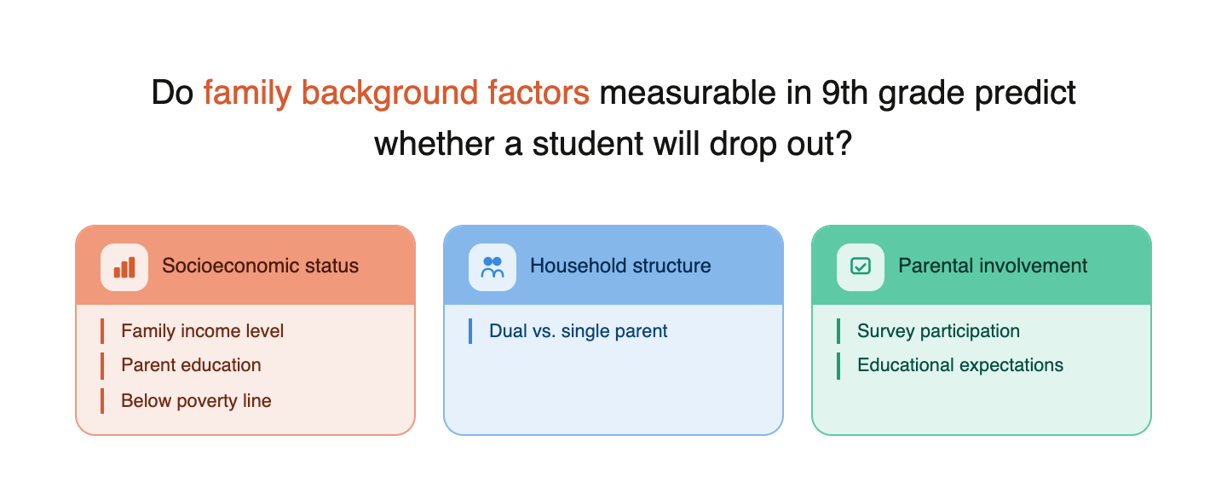
DOMAIN 1: Family & Parental Background
Notes:
This is the most consistently confirmed domain across every analysis step.
Poverty is the single strongest binary predictor in the entire dataset, parent expectations produce the highest dropout rate of any variable category, and missing parent survey data is itself informative. SES factors also amplify risk in every other domain.

Slide 22
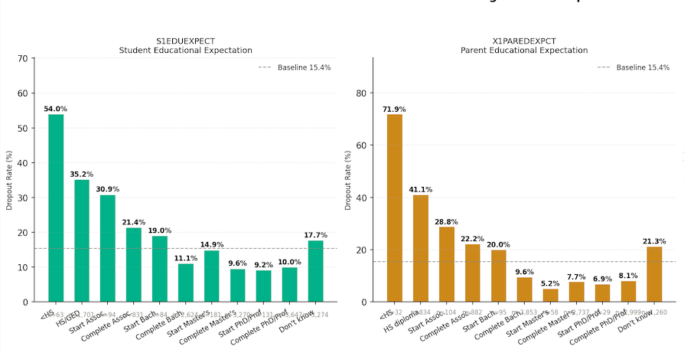
DOMAIN 1: Family & Parental Background
Notes:
71.9% — the single highest dropout rate of any variable in the entire analysis. Not grades. Not poverty. A parent's belief. Even parental UNCERTAINTY produces an above-baseline dropout rate (21.3%) which itself a warning sign. Parent Expectations Dominate Student Expectations A student's own aspirations cannot fully overcome what their parents believe is possible for them. Why r = −0.111 is misleading: Category 11 ("Don't know") is encoded as the highest numeric value but produces an elevated dropout rate (21.3%), not a low one. This breaks the monotonic relationship and collapses the linear correlation. The strongest domain in the dataset — and the most surprising
What a parent believes about their child's future is more predictive than grades, poverty, or anything else measured individually

Slide 23
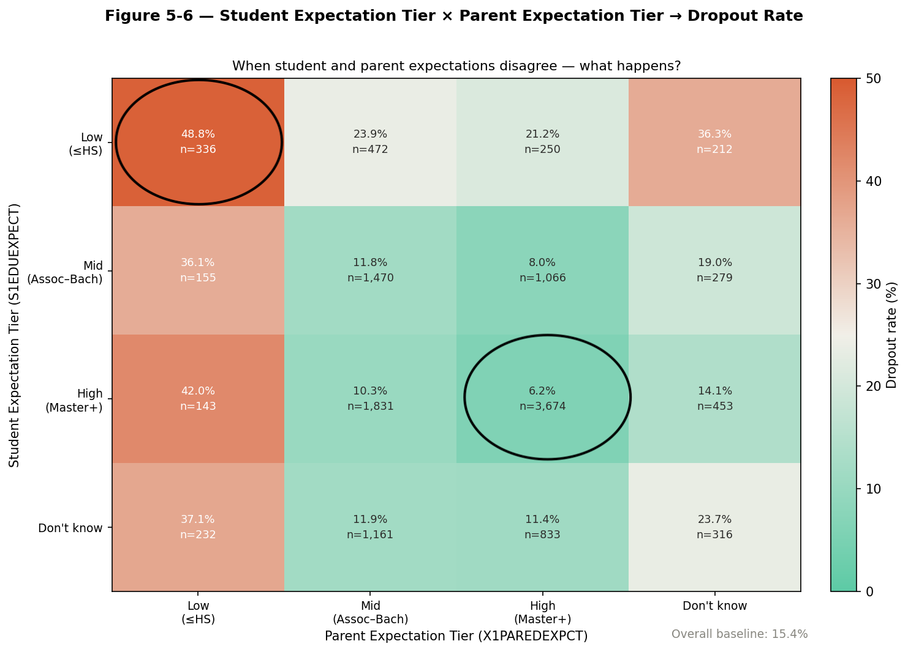
Parent Expectations Dominate Student Expectations
Notes:
Multicollinearity note: "We expected these two variables to be collinear. The data showed r = +0.127 — negligible. Parents and their children form expectations largely independently of each other." When both student and parent expectations are low (≤HS): 48.8% dropout. A student with high expectations but low-expectation parents still drops out at 42.0% — nearly as bad. Parent expectations dominate. —------> what to say Heatmap: Student tier (rows) × Parent tier (columns)
Low / Mid / High / Don't know
Highlight three cells with arrows:
Both High (Master+/Master+) → 6.2% "Best case"
Both Low (≤HS / ≤HS) → 48.8% "Worst case"
Student HIGH, Parent LOW → 42.0% ★ "Most important cell"
Annotation on the ★ cell:
"A student with high personal aspirations
but low-expectation parents drops out at 42.0%
— nearly as bad as when both are low (48.8%)"
"A student's own ambition cannot overcome
low parental expectations."
Correlation note (small, bottom corner):
"Student and parent expectations: r = +0.127
They are NOT measuring the same thing.
Both belong in the model independently."
Both High (Master+/Master+) → 6.2% "Best case"
Both Low (≤HS / ≤HS) → 48.8% "Worst case" Student HIGH, Parent LOW → 42.0% ★ "Most important cell"
Parent expectations dominate student expectations — a student with high aspirations but low-expectation parents still drops out at 42.0% nearly as bad as when both are low (48.8%)"

Slide 24
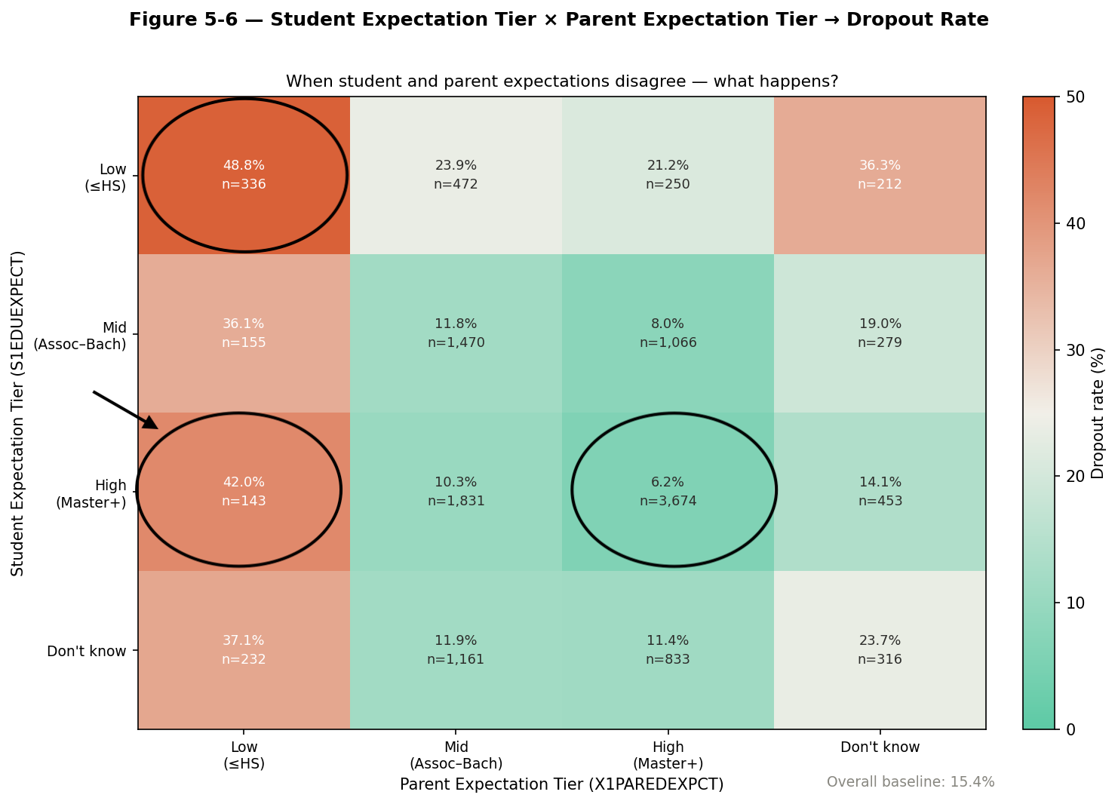
Parent Expectations Dominate Student Expectations
Notes:
Multicollinearity note: "We expected these two variables to be collinear. The data showed r = +0.127 — negligible. Parents and their children form expectations largely independently of each other." When both student and parent expectations are low (≤HS): 48.8% dropout. A student with high expectations but low-expectation parents still drops out at 42.0% — nearly as bad. Parent expectations dominate. —------> what to say Heatmap: Student tier (rows) × Parent tier (columns)
Low / Mid / High / Don't know
Highlight three cells with arrows:
Both High (Master+/Master+) → 6.2% "Best case"
Both Low (≤HS / ≤HS) → 48.8% "Worst case"
Student HIGH, Parent LOW → 42.0% ★ "Most important cell"
Annotation on the ★ cell:
"A student with high personal aspirations
but low-expectation parents drops out at 42.0%
— nearly as bad as when both are low (48.8%)"
"A student's own ambition cannot overcome
low parental expectations."
Correlation note (small, bottom corner):
"Student and parent expectations: r = +0.127
They are NOT measuring the same thing.
Both belong in the model independently."
Both High (Master+/Master+) → 6.2% "Best case"
Both Low (≤HS / ≤HS) → 48.8% "Worst case" Student HIGH, Parent LOW → 42.0% ★ "Most important cell"
Parent expectations dominate student expectations — a student with high aspirations but low-expectation parents still drops out at 42.0% nearly as bad as when both are low (48.8%)"

Slide 25
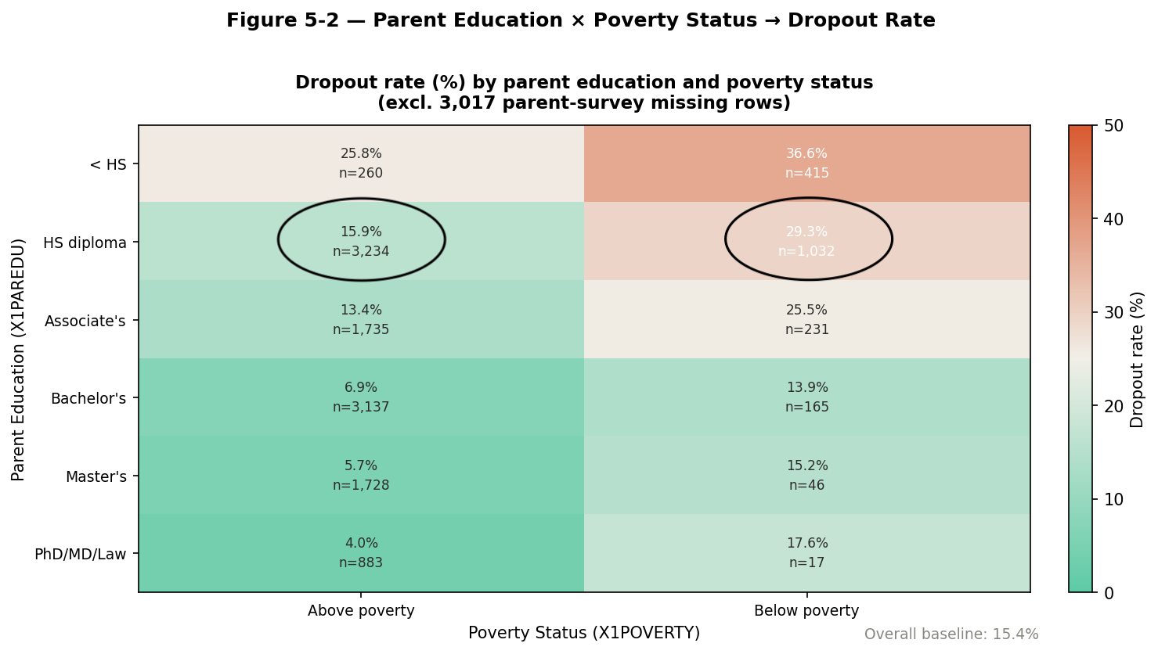
SES: Poverty Is Not Just a Risk Factor
Notes:
(Parent Education × Poverty heatmap)
Best case: PhD/MD/Law + above poverty → 4.0% Worst case: < HS + below poverty → 36.6% Ratio: 36.6 / 4.0 = 9.15× — nearly 9× difference
Highlight HS diploma row:
Above poverty: 15.9% → Below poverty: 29.3%
"Poverty nearly doubles the risk for HS-educated families"

Slide 26
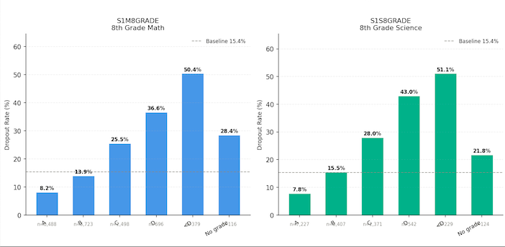
Domain 2: Academics
Notes:
Does academic performance before high school predict dropout?
A student arriving in 9th grade with below-D 8th-grade grades is … S1S8GRADE / S1M8GRADE (8th-Grade Grades)
Spearman r: +0.242 / +0.229 (strongest linear correlates) Bivariate: A grade → 7.8%/8.2% dropout
Below D → 51.1%/50.4% dropout
Monotonic staircase — every grade step worsens dropout risk
Multivariate: Combined with graduation certainty (S1SUREHSGRAD) → 7.0% to 69.7% range
The widest spread of any feature combination in the entire analysis

Slide 27
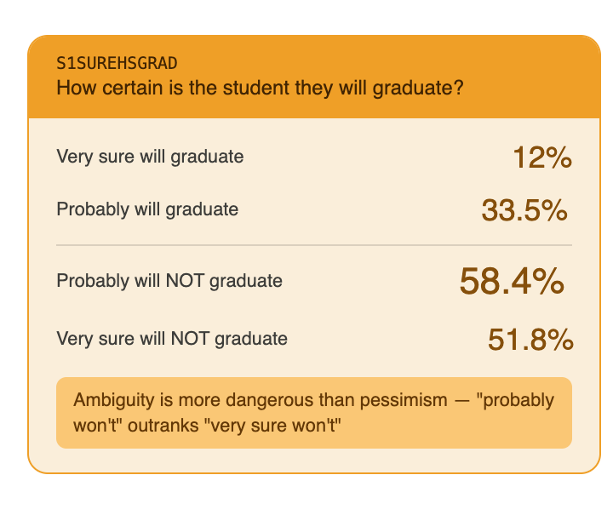
Domain 3: Student Motivation & Attitudes
Notes:
Do a student's own educational expectations, their confidence in graduating, and their attitudes toward school and college access predict dropout risk in 9th grade?

Slide 28
05
Feature Selection

Slide 29
Feature Engineering: Building Better Signals
Parent Survey → A Missing-Data Feature 3,017 students had parents who never responded to the survey — all parent variables blank. Rather than just imputing over it: → Created X1PAR_SURVEY_MISSING as a standalone flag → Result: 24.3% dropout when parent is absent vs 13.3% when present — one of the strongest binary predictors in the entire dataset "Parents who don't engage with the survey often have students who don't engage with school."
Household Structure → One Binary Feature X1PARPATTERN had 9 complex household categories (biological two-parent, single mother, guardian, etc.) → Collapsed into X1_DUAL_PARENT: does the student have 1 or 2 parent figures? → Result: Single-parent households drop out at 2× the rate (22.1% vs 10.8%) "Nine categories, but one question matters: is there a second adult in the picture?"

Slide 30
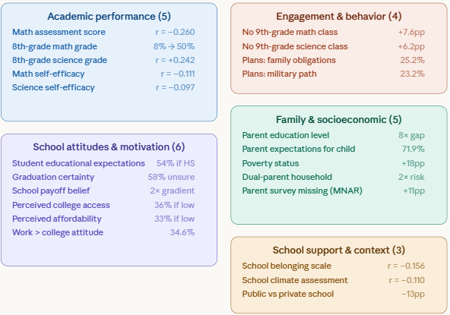
Feature Engineering: Building Better Signals
23 features — selected by 3 criteria from EDA
Top — The 3 selection criteria (one line each):
Spearman correlation with dropout target
Bivariate dropout rate gaps across categories
Multicollinearity checks between predictors

Slide 31
06
Modeling and Results

Slide 32
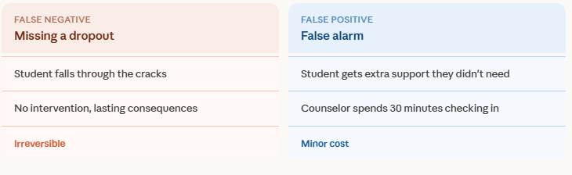
Our Metric
Missing an at-risk student is more costly than flagging a student who may not eventually drop
Recall: of all students who actually dropped out, how many did we catch?

Slide 33
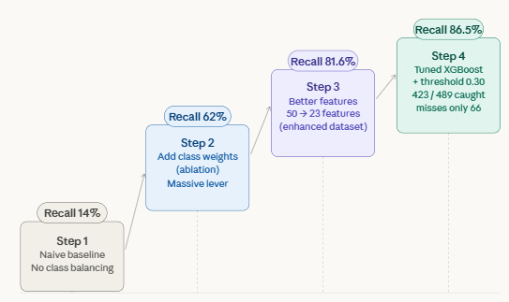
The Journey: 14% → 86.5%
Building a model that catches 6× more at-risk students
The ablation study proved both levers matter: class weighting for awareness, feature engineering for precision

Slide 34
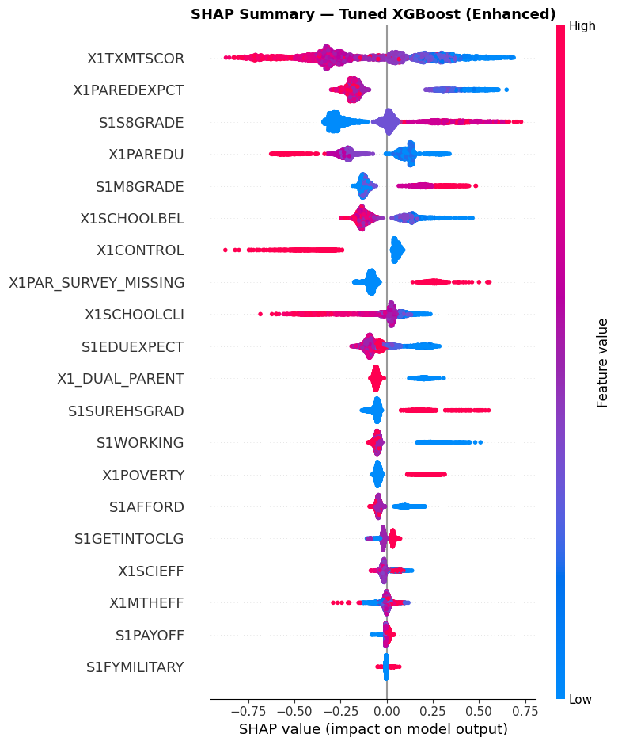
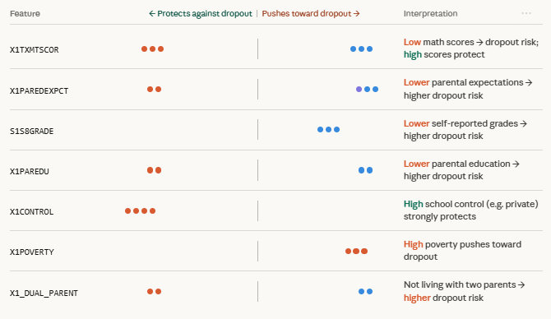
"Top Predictors" (SHAP summary)

Slide 35
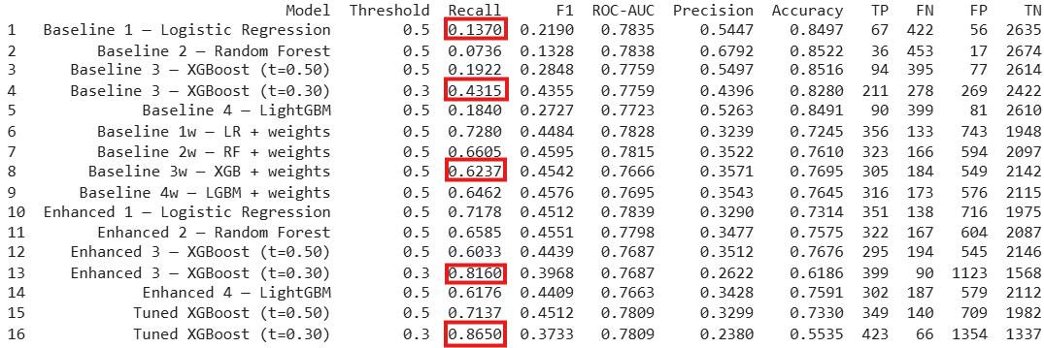
Models Comparison - Results

Slide 36
07
Business Recommendation & Further Steps

Slide 37
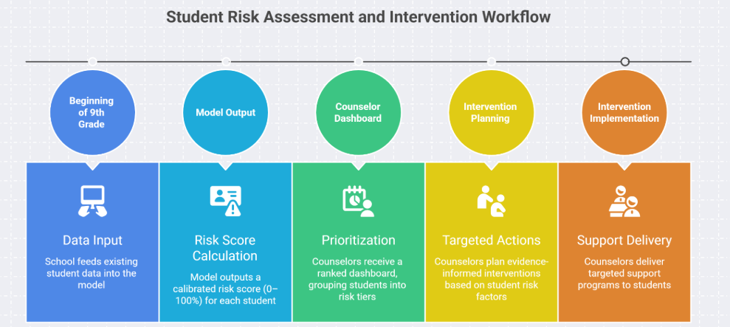
From Prediction to Action
How schools can use the model as an early-warning system

Slide 38
From Prediction to Action
How schools can use the model as an early-warning system
DEMO!

Slide 39
What’sNext
This is the beginning, not the end
1. Wave 2 Comparison Our proposal includes comparing 9th-grade-only prediction with 11th-grade data, does waiting two more years meaningfully improve the model, or can we intervene earlier?
2. Real-World Validation This model was trained on U.S. national data from 2009. The next step is testing it on more recent cohorts and local school districts to see if the patterns hold.

Slide 40
Thank You!
Do you have any questions?

